Slide 1

End-to-end deep learning
What is
end-to-end
deep learning
deeplearning.ai

Slide 2
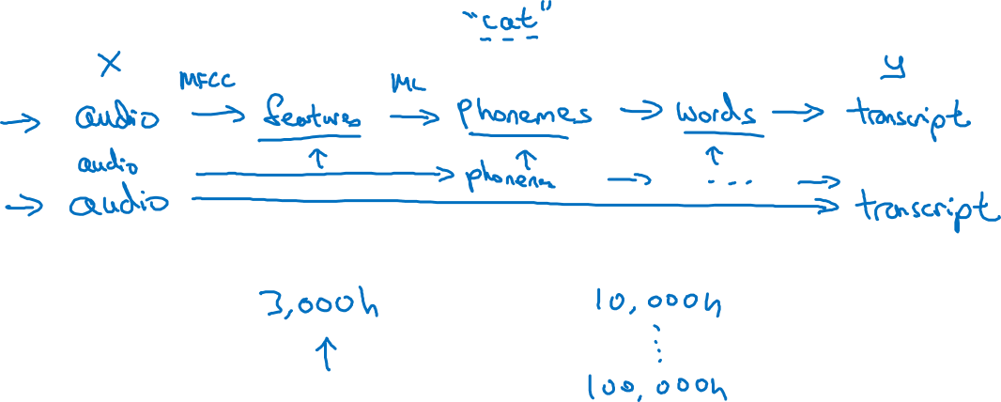
What is end-to-end learning?
Speech recognition example
Notes:
So when you have a smaller data set,
the more traditional pipeline approach actually works just as well.
Often works even better.
And you need a large data set before the end-to-end approach really shines

Slide 3

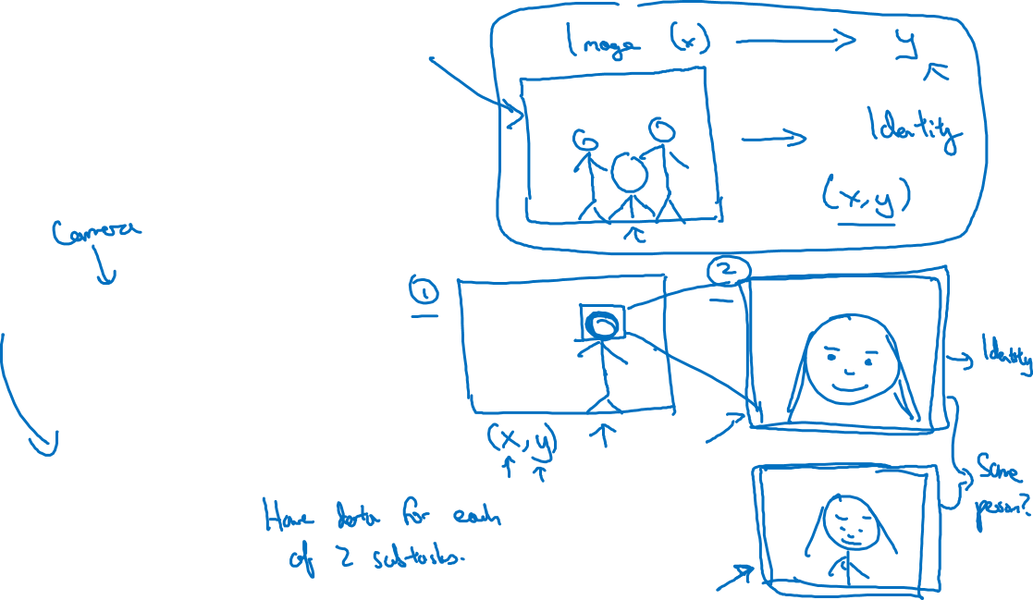
Face recognition
[Image courtesy of Baidu]
Notes:
breaking this problem down into two simpler steps,
first is figure out where is the face.
And second, is look at the face and figure out who this actually is.
.So why is it that the two step approach works better?
There are actually two reasons for that.
One is that each of the two problems you're solving is actually much simpler.
But second, is that you have a lot of data for each of the two sub-tasks.
In particular, there is a lot of data you can obtain for phase detection,
for task one over here,
where the task is to look at an image and figure
out where is the person's face and the image.
So there is a lot of data.
There is a lot of label data X,
comma Y where X is a picture and y shows the position of the person's face.
So you could build a neural network to do task one quite well.
And then separately, there's a lot of data for task two as well.
Today, leading companies have let's say,
hundreds of millions of pictures of people's faces.
So given a closely cropped image,
like this red image or this one down here,
today leading face recognition teams have
at least hundreds of millions of images that they could
use to look at two images and try to
figure out the identity or to figure out if it's the same person or not.
So there's also a lot of data for task two.
But in contrast, if you were to try to learn everything at the same time,
there is much less data of the form X comma Y.
Where X is image like this taken from the turnstile,
and Y is the identity of the person.
So because you don't have enough data to solve this end-to-end learning problem,
but you do have enough data to solve sub-problems one and two, in practice,
breaking this down to two sub-problems results in
better performance than a pure end-to-end deep learning approach.

Slide 4
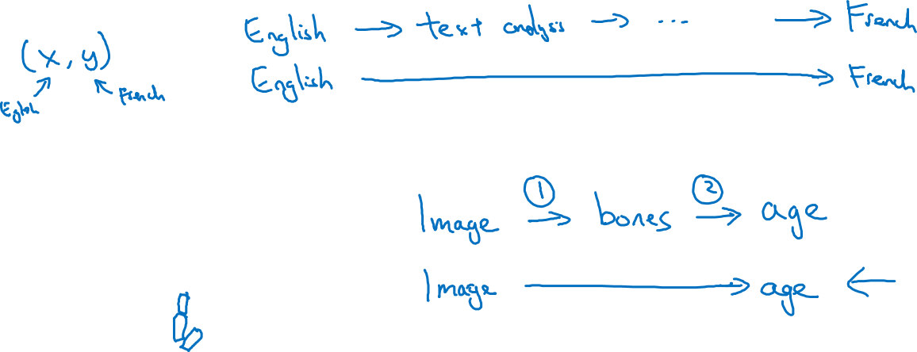
More examples
Machine translation
Estimating child’s age:

